Slide 1

Electricity Theft Detection
and Billing Anomaly System
CSA0202 – C Programming for networking
Done By:
C ABHINAY ADITHYA (192572185
K DHANUSH SRIVATSAN (192524503)
MOHAMED HASID (192521674)
Guided By:
DR.V.JAYASUDHA

Slide 2


LOGO
ABSTRACT
LOGO
➤ This is about a C-based system designed to monitor electricity consumption and detect fraud in power distribution.
➤ It stores and manages consumer meter readings, comparing actual usage against expected consumption patterns.
➤ The system identifies suspicious spikes, illegal connections, and billing fraud using detection algorithms.
➤ A billing engine computes monthly charges, flags discrepancies, and generates reports for each consumer.
➤ Implemented in C using structures, file handling, arrays, pointers, and functions across three modules.

Slide 3
LOGO
INTRODUCTION
LOGO
➤ Electricity theft is one of the most serious problems faced by power distribution companies worldwide.
➤ Consumers tap power lines illegally, tamper with meters, or manipulate readings to avoid paying bills.
➤ automates fraud detection by monitoring consumption and flagging suspicious accounts.
➤ It compares current and previous readings to identify unusual drops or spikes automatically.
➤ The system is developed using C programming to simulate a real electricity board fraud detection unit.

Slide 4
LOGO
PROBLEM ANALYSIS
LOGO
➤ Illegal power tapping bypasses electricity meters, causing massive unmetered consumption losses.
➤ Meter tampering using magnets or physical damage records lower consumption than actual usage.
➤ Billing fraud occurs when meter readers manipulate readings, leading to severe undercharging.
➤ Power boards lose 20 to 40 percent of generated electricity due to theft and technical losses.
➤ Manual inspection is slow, expensive, and unreliable, allowing theft to go undetected for months.

Slide 5
LOGO
SOLUTION STATEMENT
LOGO
➤ Design a C-based system to register consumers, store readings, and maintain account records using file handling.
➤ Implement an anomaly detection engine to identify sudden spikes or drops in consumption automatically.
➤ Build a threshold-based fraud detection algorithm to flag accounts showing bypass or tamper patterns.
➤ Create a billing module that calculates charges, detects discrepancies, and generates formatted reports.
➤ Display a fraud dashboard showing flagged consumers, risk levels, and audit logs via a console-based UI.

Slide 6
LOGO
MODULE 1
LOGO
Purpose
To register electricity consumers, record meter readings, manage accounts, and store all consumer data using C structures and file handling.
➤ Add Consumer – Register new consumers with name, ID, address, and meter number.
➤ Record Reading – Store monthly meter readings with date and timestamp.
➤ Search Consumer – Search by consumer ID or name instantly from file.
➤ Update Details – Modify consumer information and correct wrong readings.
➤ File Storage – All consumer data saved to .txt or .dat files for persistence.

Slide 7
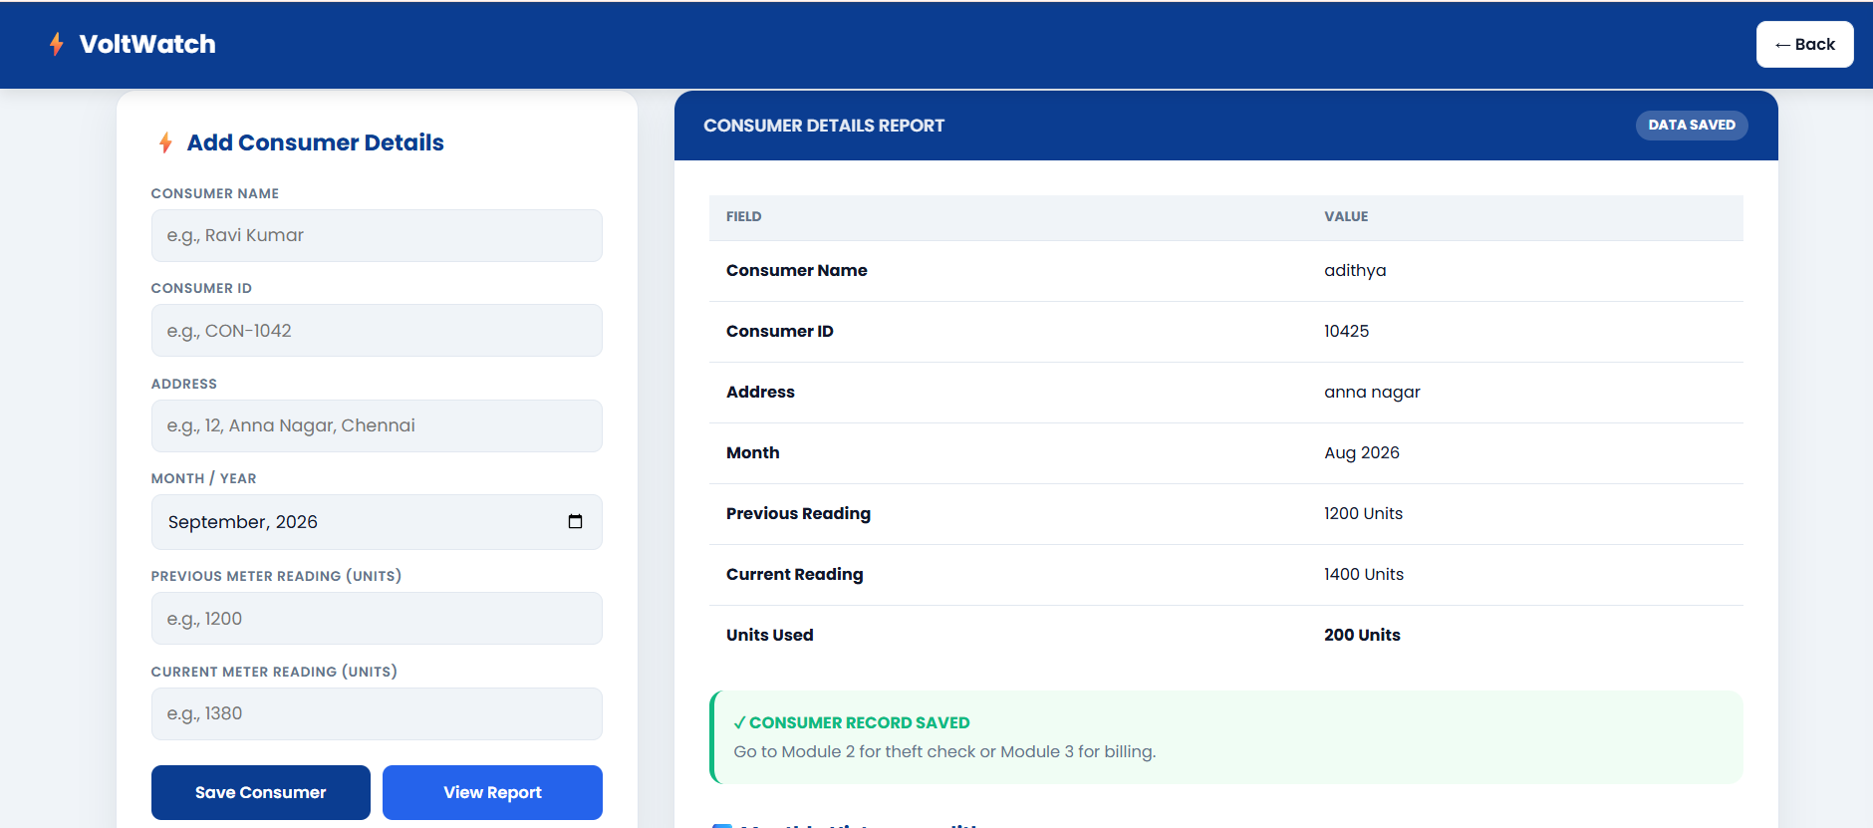
LOGO
MODULE 1
LOGO

Slide 8
LOGO
MODULE 2
LOGO
Purpose
To analyze meter readings, compare usage against baselines, detect illegal connections, and flag suspicious consumers using C algorithms.
➤ Spike Detection – Flags consumers with usage more than 150 percent of their average.
➤ Drop Detection – Zero or near-zero usage flags a potential meter bypass situation.
➤ Illegal Tap Alert – Cross-checks transformer load against total recorded consumer usage.
➤ Alert Generation – Assigns risk level as LOW, MEDIUM, HIGH, or CRITICAL.
➤ Audit Log – Saves all flagged events with timestamp to a log file using file handling.

Slide 9
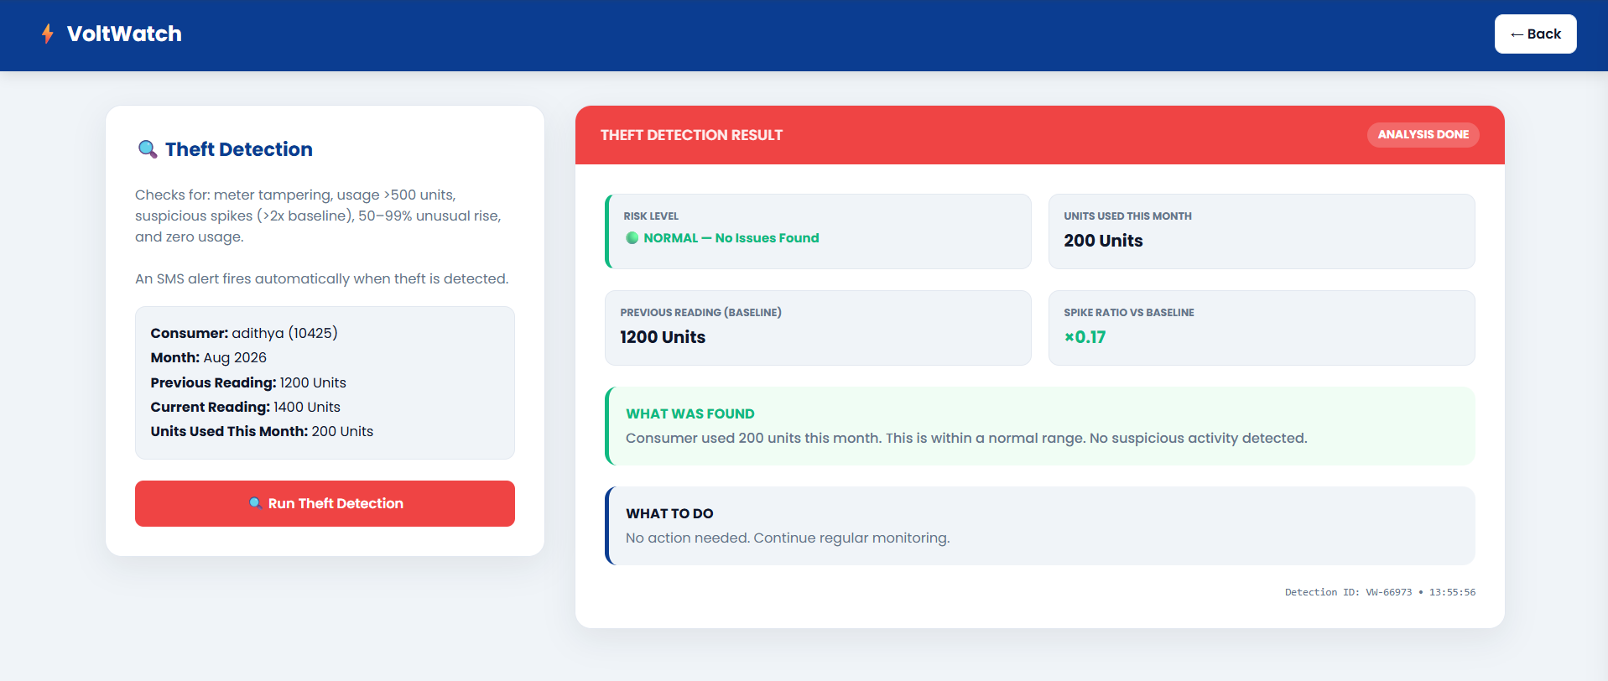
LOGO
MODULE 2
LOGO

Slide 10
LOGO
MODULE 3
LOGO
Purpose
To generate monthly electricity bills, detect billing anomalies, produce fraud summary reports, and display a dashboard of all flagged consumers.
➤ Bill Generation – Calculates bill as units multiplied by rate plus 18 percent GST.
➤ Anomaly Check – Compares billed amount against expected amount for that consumer area.
➤ Report Export – Saves a formatted monthly report to a text file using fprintf.
➤ Category Tags – Applies Residential, Commercial, and Industrial billing rates separately.
➤ Fraud Summary – Displays a list of all flagged consumers with their risk scores.

Slide 11
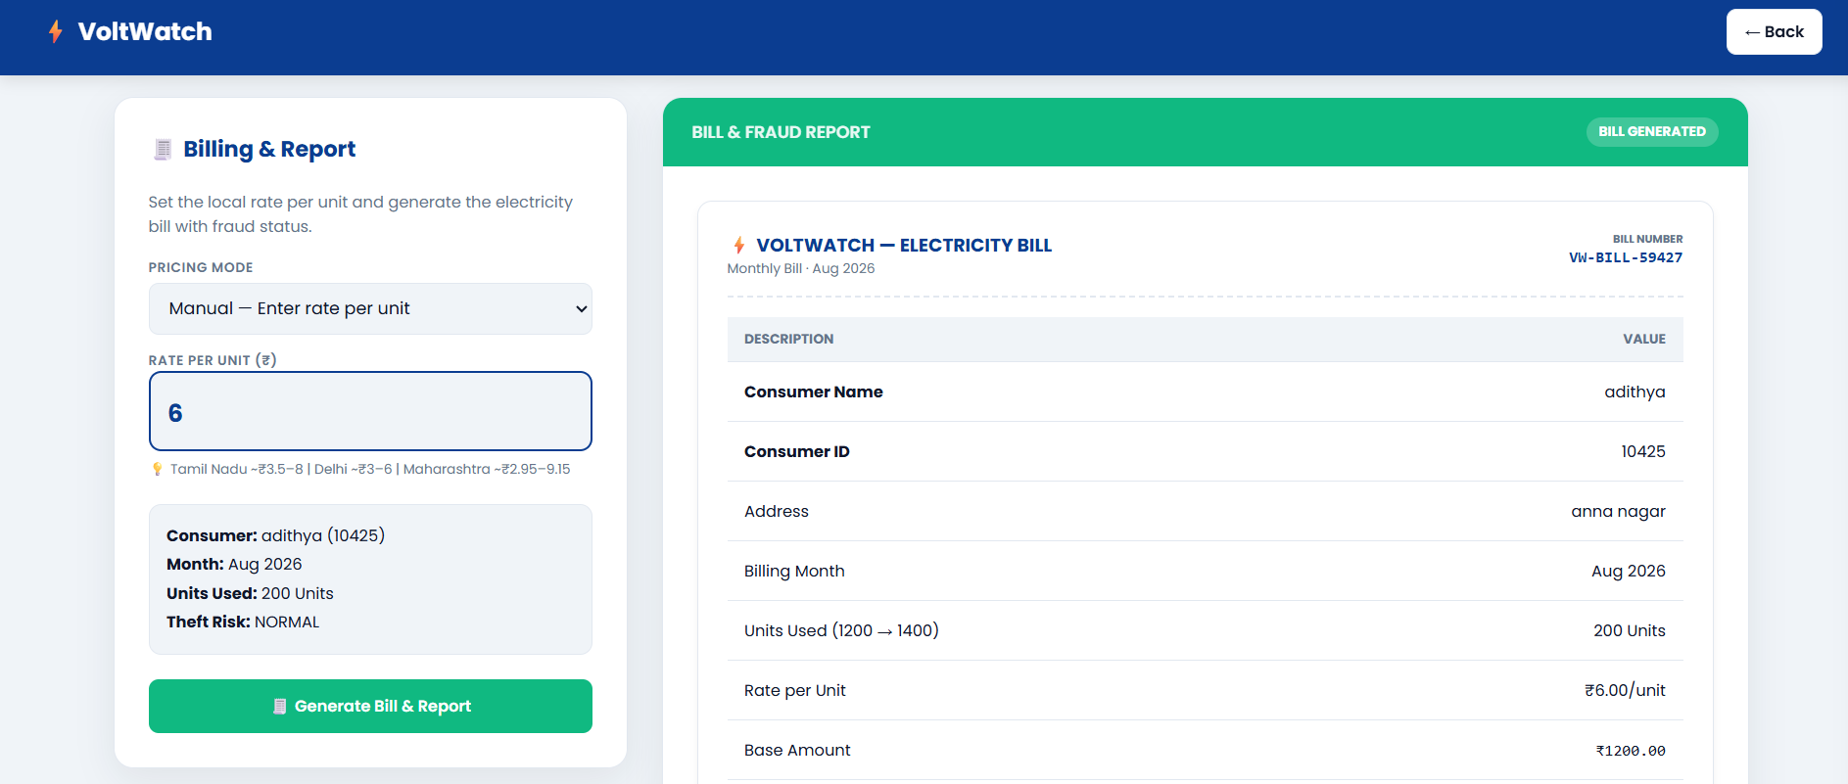
LOGO
MODULE 3
LOGO

Slide 12
LOGO
LIMITATIONS
LOGO
➤ The project is a software simulation and does not use real physical smart meters or IoT sensors.
➤ All readings are entered manually by the user, so accuracy depends entirely on the input provided.
➤ No real-time data streaming — readings are batch-processed per session only.
➤ No user authentication or role-based access control is implemented in this version.
➤ Console-based interface only — no graphical user interface in the C application itself.

Slide 13
LOGO
FUTURE ENHANCEMENTS
LOGO
➤ Integrate IoT smart meters for automatic real-time electricity reading collection.
➤ Use AI and machine learning models to detect complex theft patterns more accurately.
➤ Build a web-based dashboard to visualize consumption data, charts, and fraud alerts.
➤ Develop a mobile app for consumers to view bills, pay online, and report suspicious activity.
➤ Send automated SMS and email alerts to authorities whenever fraud is detected.

Slide 14
LOGO
CONCLUSION
LOGO
➤ This implements a complete electricity theft detection and billing anomaly system using C programming.
➤ The three-module structure covers consumer management, fraud detection, and billing end-to-end.
➤ The system addresses the real-world problem of electricity theft causing billions in annual losses.
➤ Core C concepts — structures, file handling, pointers, arrays, and functions — are used throughout.
➤ It can be extended into a production-grade smart metering solution with IoT and web integration.

Slide 15
REFERENCES
1. Depuru, S. S. S. R., Wang, L., & Devabhaktuni, V. (2011). Electricity theft: Overview, issues, prevention and a smart meter based approach to control theft. Energy Policy, 39(2), 1007–1015.
2. Jokar, P., Arianpoo, N., & Leung, V. C. M. (2016). Electricity theft detection in AMI using customers’ consumption patterns. IEEE Transactions on Smart Grid, 7(1), 216–226.
3. Nizar, A. H., Dong, Z. Y., & Wang, Y. (2008). Power utility nontechnical loss analysis with extreme learning machine method. IEEE Transactions on Power Systems, 23(3), 946–955.
4. ScienceDirect – Machine Learning Techniques for Electricity Theft Detection in Smart Grids (2024).
5. IEEE Xplore – Smart Meter Data Analytics for Billing Anomaly and Fraud Detection (2023).

Slide 16
LOGO
LOGO
THANK YOU

